Slide 1

emlix GmbH – We realize industrial-grade Linux
An Overview of my Company
By Frank Michael Becker

Slide 2
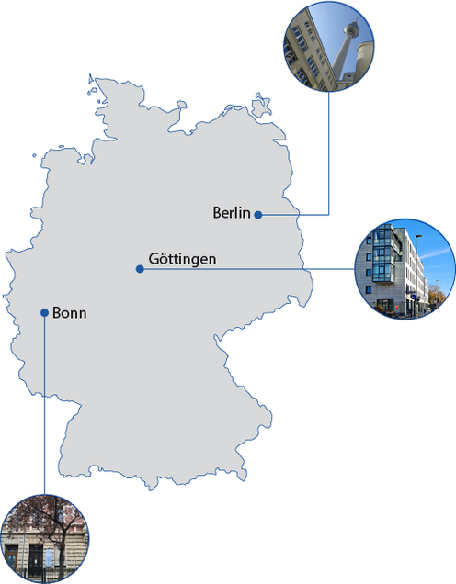
About emlix GmbH
An Overview of my Company:
  Headquarter in Göttingen
  ~ 50 Employees (GÖ, B, BN)
  Embedded Linux Systems
  International customers

Slide 3

Our Services and Expertise
List of Services:
  Customer Orders
  But also own Projects
  Mainly Software Development
  OS Development
I work with elos

Slide 4


Our Core Values
Innovative Software
Integrity with many OS
Customer focused Development
Open Source

Slide 5
Now what is elos?
Event Logging and Managment System
Collect, store and publish system events
  Syslogs, core dumps, measurements obtained from proc- and sys-fs, …
Easy access to the collected data
Easily extensible
Librarys for major languages
Arose from a project from Elektrobit

Slide 6
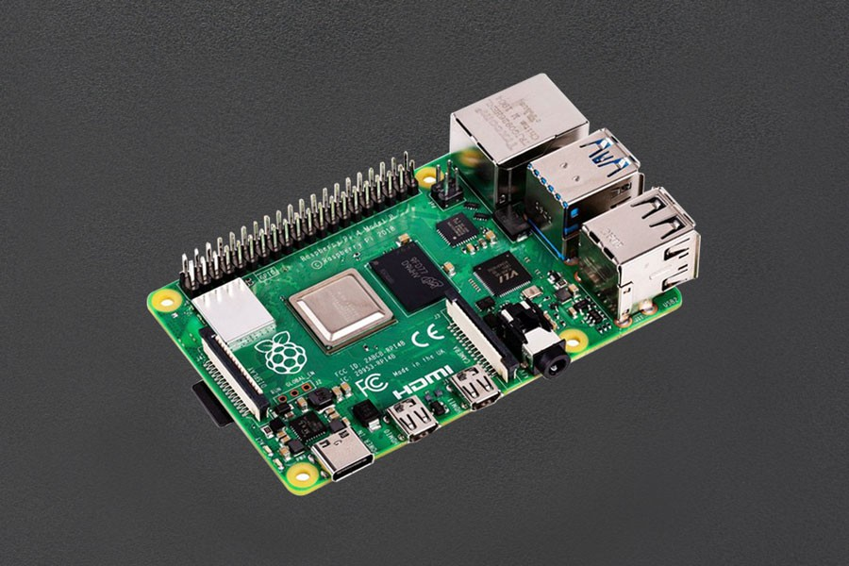
What is my Job / What do I do?
Demo-Build for elos
  RaspberryPi4
  Buttons
  Gyroscope
  Potentiometer
  LED-Ring (For Output)

Slide 7
END
To Continue…
Or not…
Who knows?
Well I don‘t…
Thanks for listening!

